Slide 1



Data Professional Survey Analysis
View in Power BI
Last data refresh:
29/09/2022 17:11:47 UTC
Downloaded at:
29/09/2022 18:21:09 UTC

Slide 2
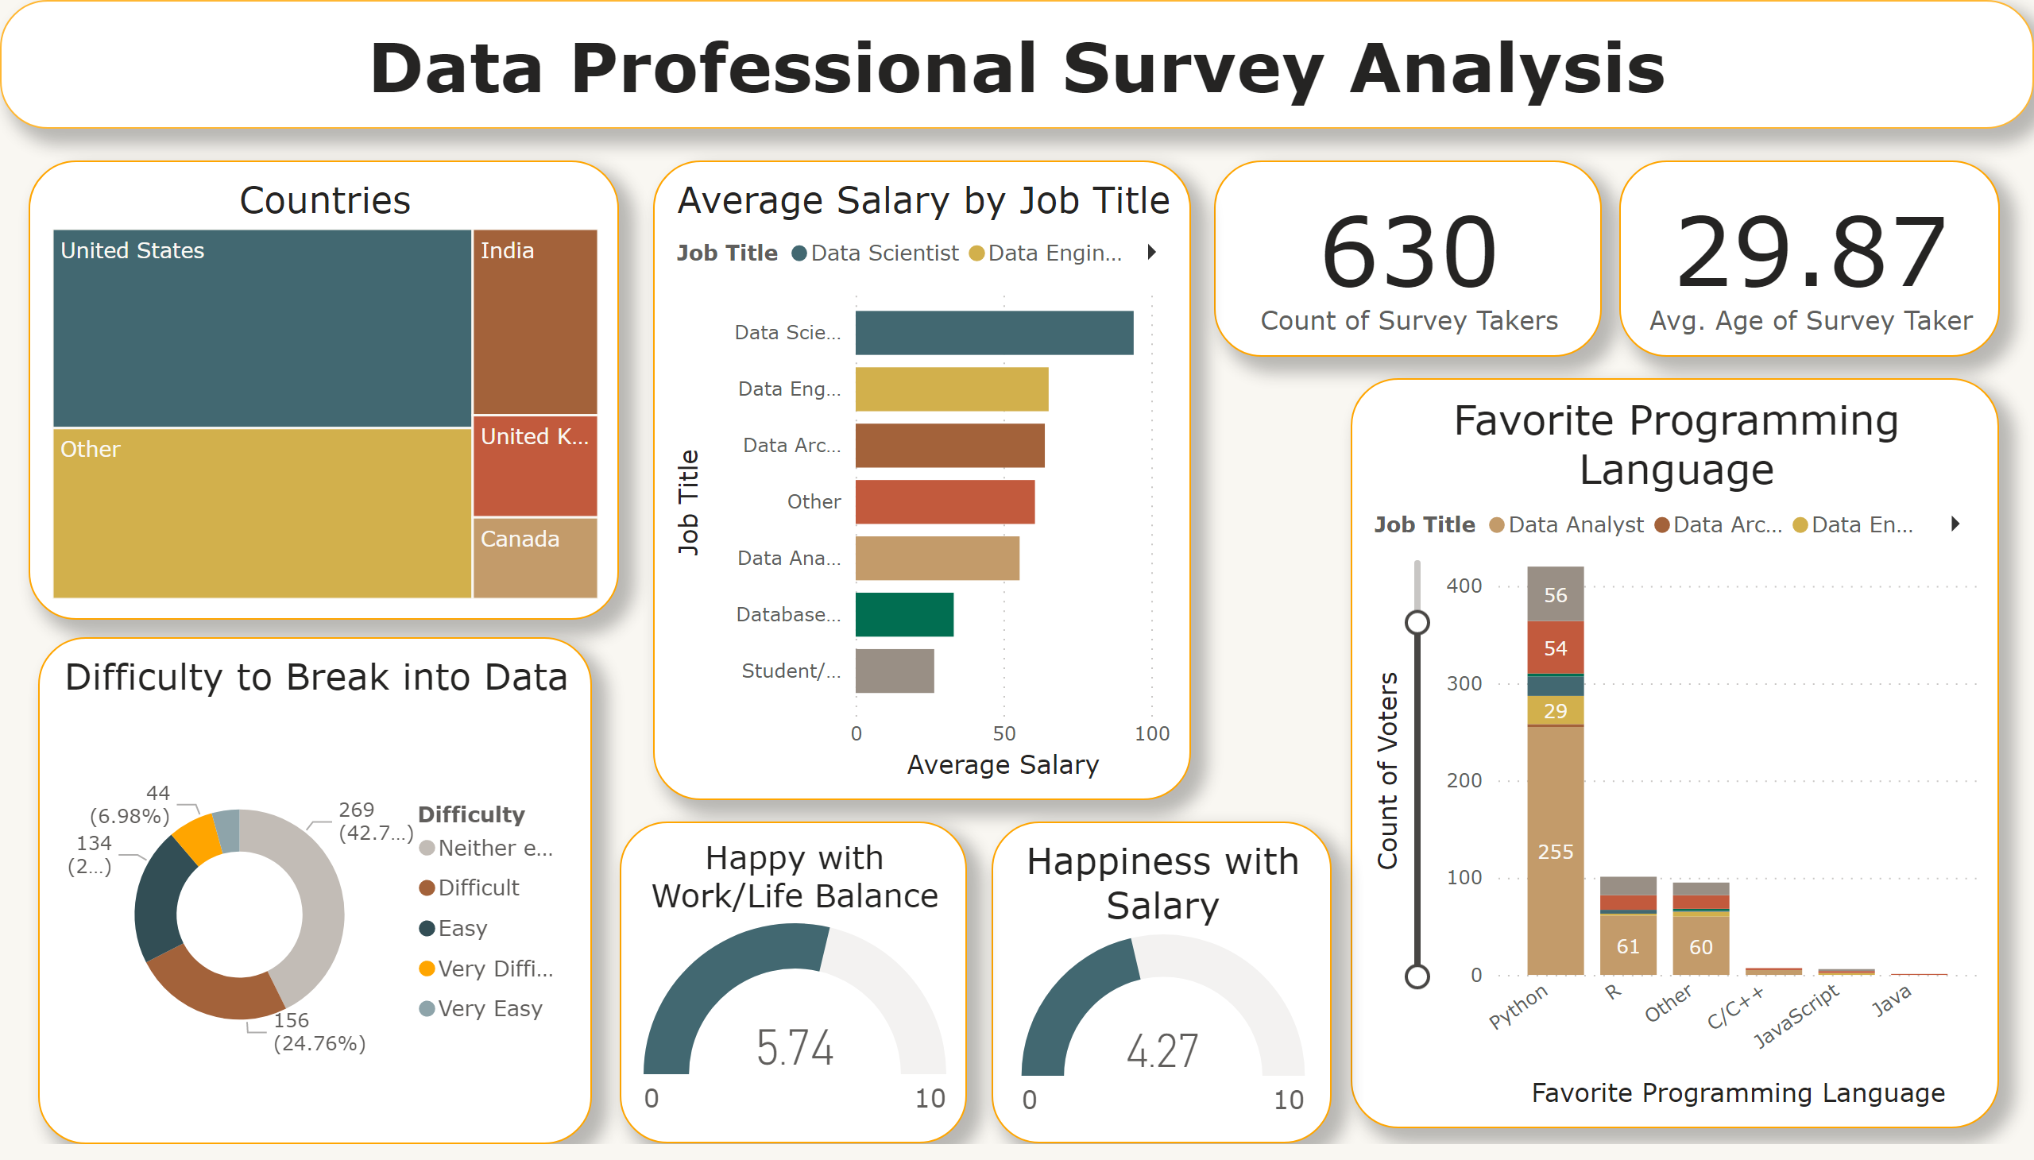
Page 1
Notes:
card
No alt text provided
card
No alt text provided
Average Salary by Job Title
No alt text provided
Favorite Programming Language
No alt text provided
Countries
No alt text provided
Happiness with Salary
No alt text provided
Happy with Work/Life Balance
No alt text provided
Difficulty to Break into Data
No alt text provided
textbox
No alt text provided

